Slide 1
Morse-pi project
Morse code in the modern world
BY CHIGOZIE AHAM and Andrew McGuire

Slide 2
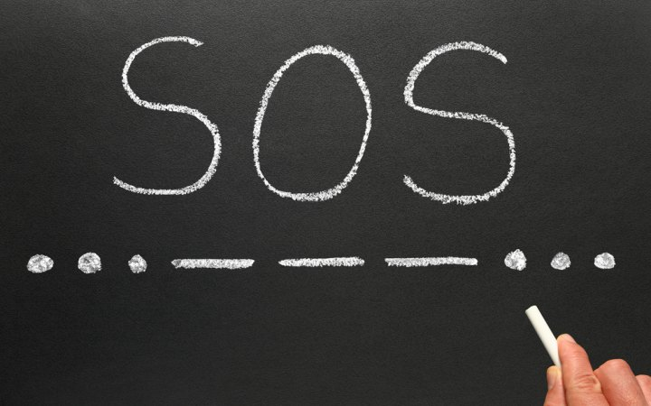
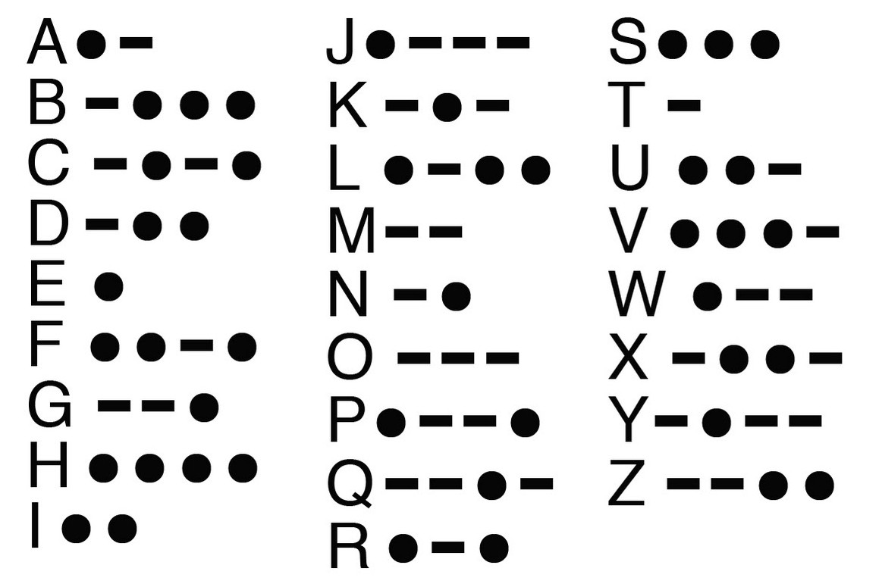
BACKGROUND
Morse-pi project is a project that explores the use of Morse codes in modern day. It consists of a hardware and software component. The hardware includes two raspberry-pi devices that are able to exchange messages in Morse codes and translated thereafter. The messages are saved on a remote server and can be viewed in an Android application, Project code.

Slide 3
COMPONENTS
There are two major hardware components, which are:
Raspberry pi x2
mini LCD screen x2
Single contact key x2
Android mobile device
The software components consist of:
Linux core
MySQL and HeidiSQL for UI database control
Java
Python 3
Raspbian OS
Making of the Morse-pi project

Slide 4
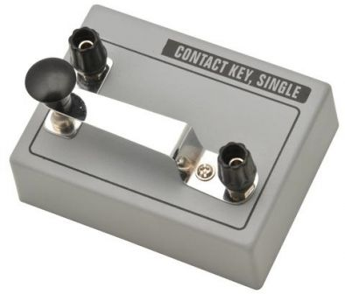
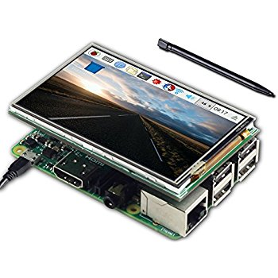
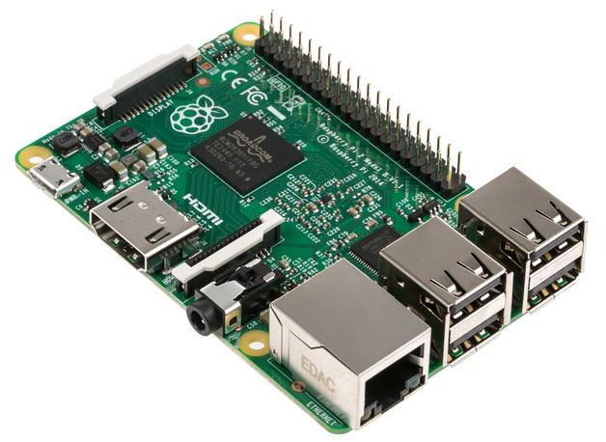
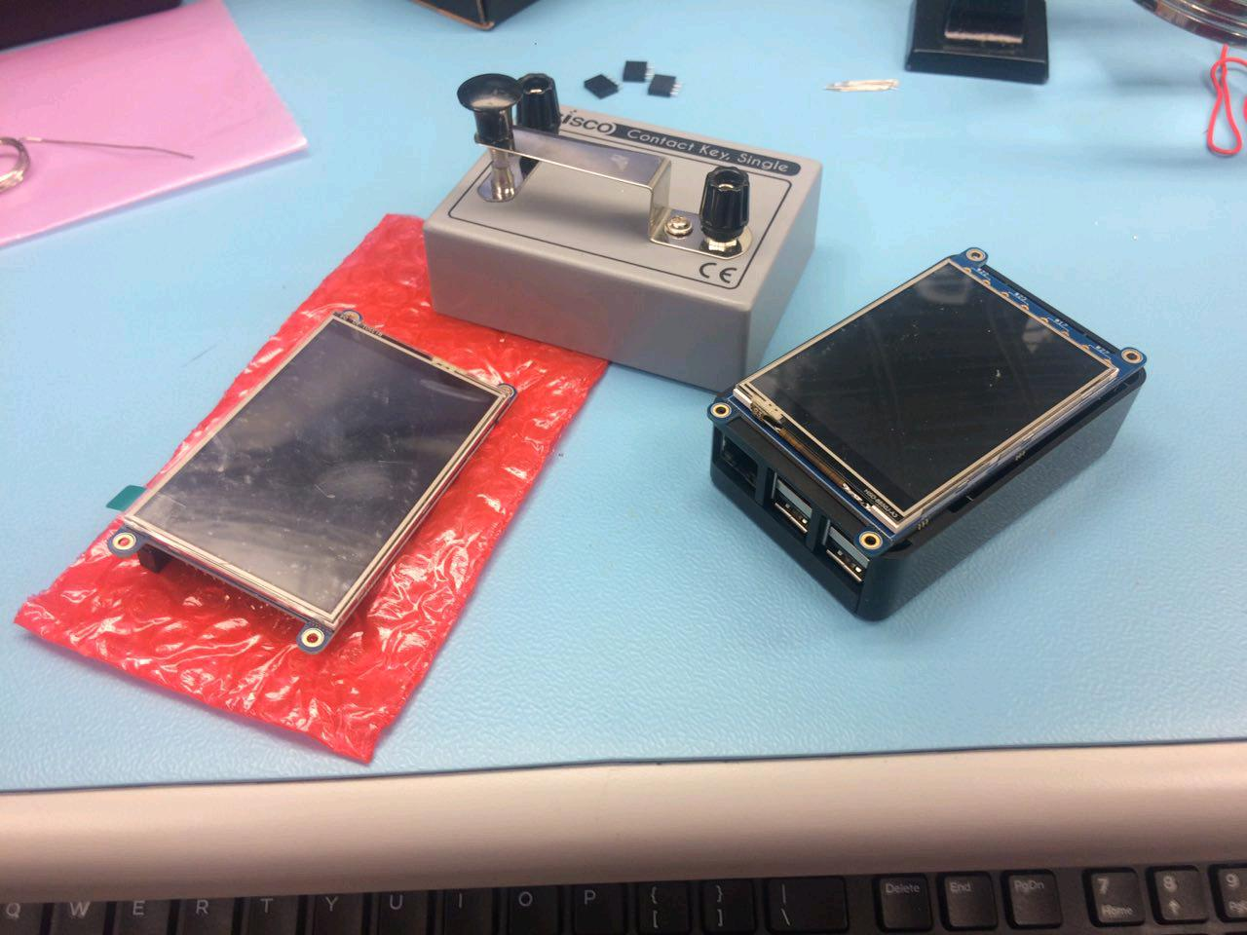



Budget and Hardware parts
$$+$$
$$+$$
$$=$$
Single contact key = $9.77CAD x 2
320x240 LCD = $39.95CAD x 2
Raspberry pi 3 = $99.99CAD x 2
Complete set = $338.34CAD including tax

Slide 5
Resources needed for Successful testing
Stable network connection
Python code for compiling computer instructions
MySQL for database needs
Java for Android programming
Remote server for hosting database

Slide 6
Guide
Requirements of Morse and how it works in our system

